Slide 1
Continuous Time Systems
Signals and Communication Systems (SCS)
Session-9 & 10

Slide 2

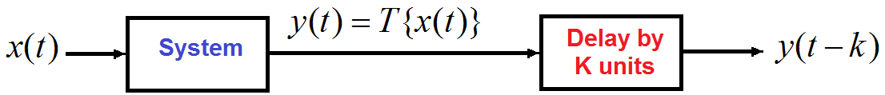

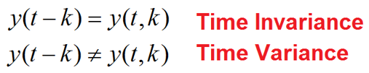
4. Time-Invariant versus Time Variant
A relaxed system T is said to be time invariant or shift invariant, if the system response does not change with time.
For every input x(t) and for every time shift ‘k’.

Slide 3
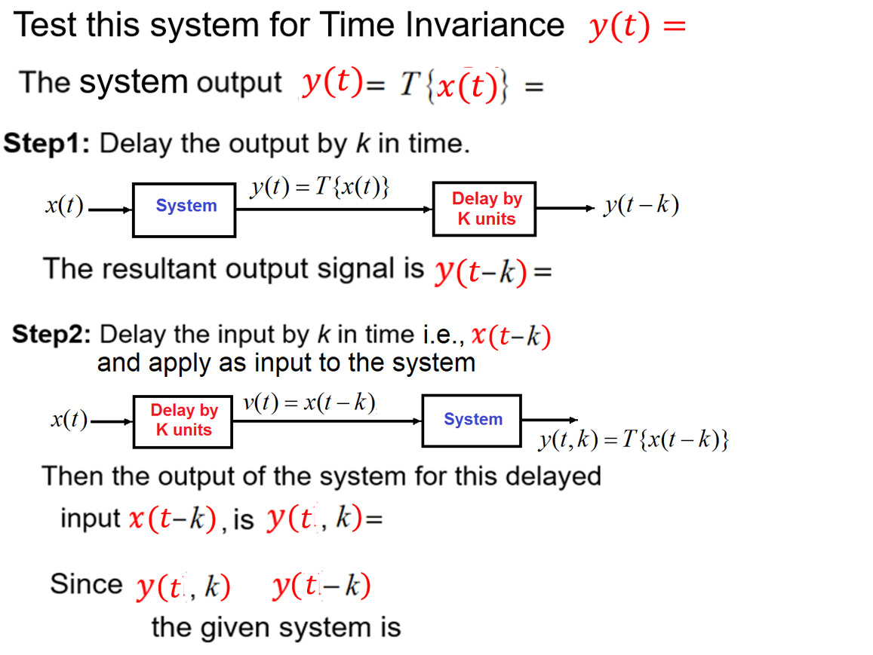

Slide 4
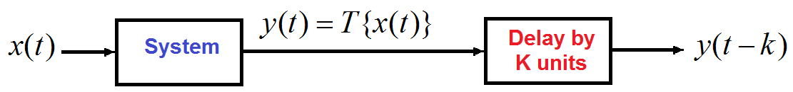
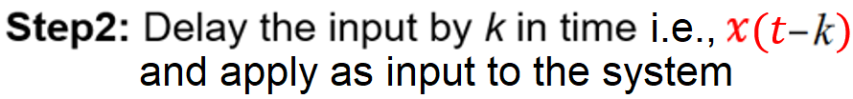
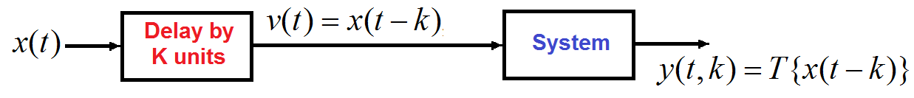
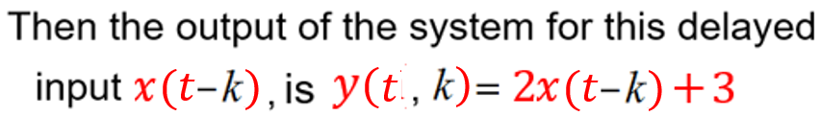
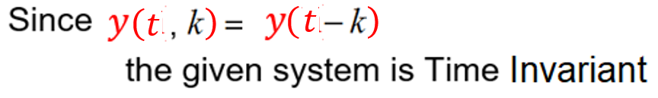
which is 2 times input plus 3

Slide 5
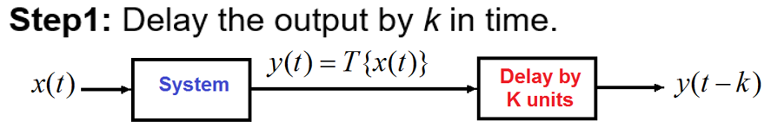
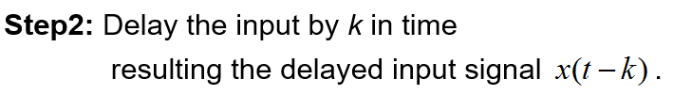

Test this system for Time Invariance

Slide 6



which is compressed the input by 2 times

Slide 7



which is time reversal of input and shift right by 2 units

Slide 9
Time-invariant versus time-variant systems
Time-invariant
Time-variant
Time-variant

Slide 10
5. Stable versus Unstable systems
A stable system is such that well-behaved outputs are obtained for well-behaved inputs.
A system is said to be bounded input bounded output (BIBO) stable, if and only if every bounded input results in a bounded output.

Slide 11





Slide 12




Slide 13
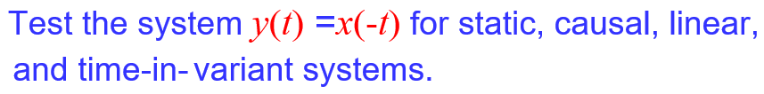









Slide 14







$$\left.\left.y\left.(\right.t)\right.=x\left.(\right.t−2)\right.$$

Slide 15
End

